Slide 1
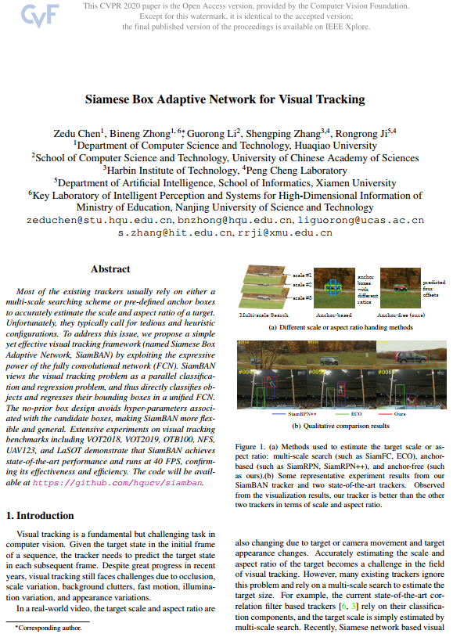
Seminar Presentation (11th July 2020)
Siamese Box Adaptive Network for Visual Tracking
(SiamBAN)
Published in CVPR-2020
Presented by:
Md. Maklachur Rahman School of Computer Science and Engineering
Kyungpook National University
Republic of Korea

Slide 2
Main Contributions
They introduce fully conventional anchor-free siamese networks for visual tracking.
They considered visual tracking problem as a parallel of classification and regression problem, and thus directly classifies objects and regresses their bounding boxes.
Their method avoids hyper-parameters associated with the candidate boxes, making SiamBAN more flexible and general.

Slide 3
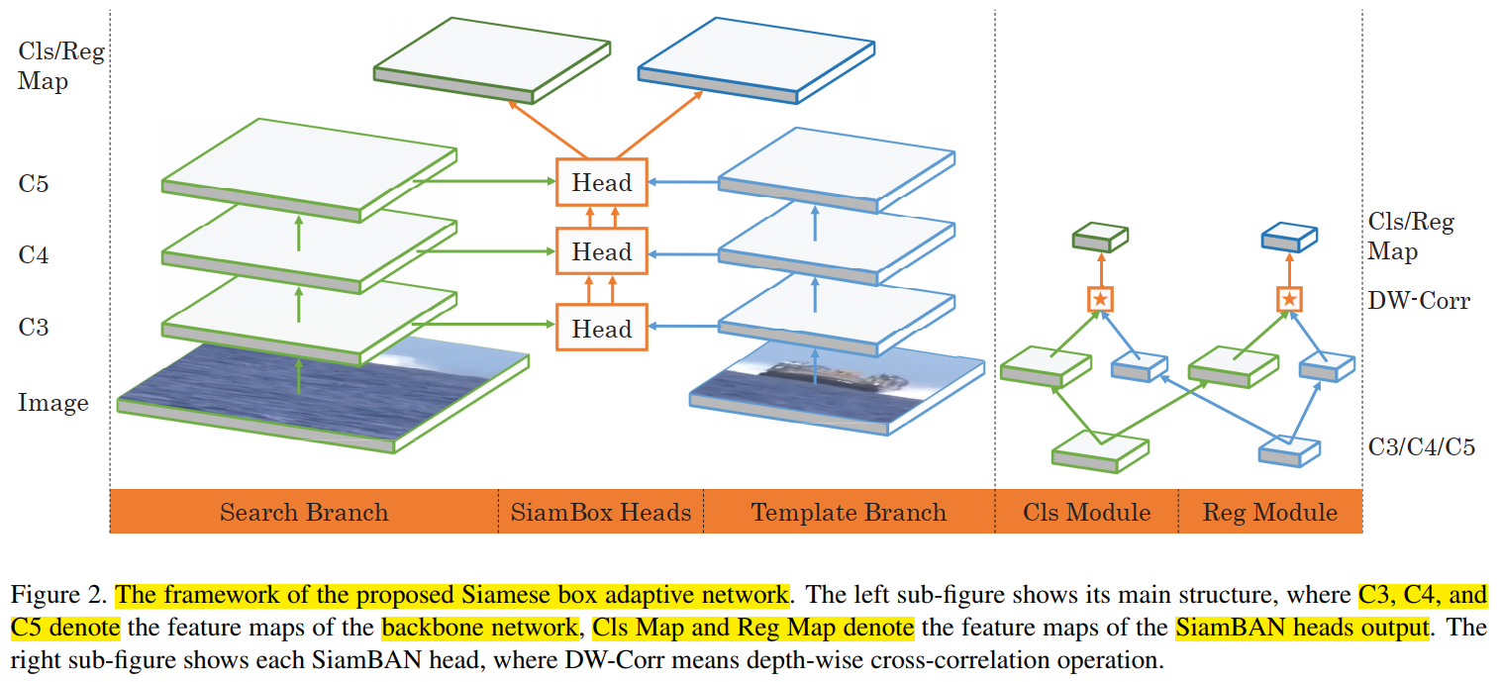
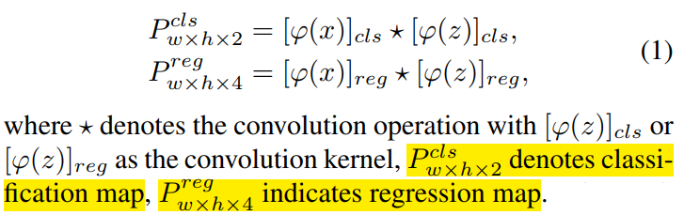
Tracker Framework
Head
Box adaptive head consists of a classification and regression module.

Slide 4
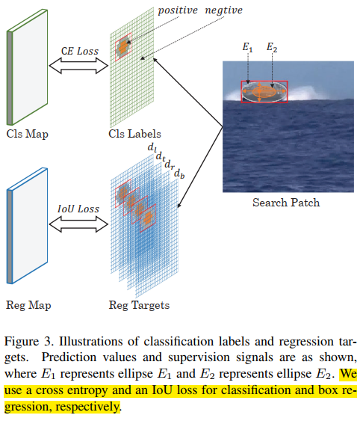
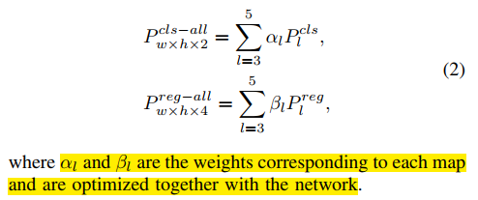
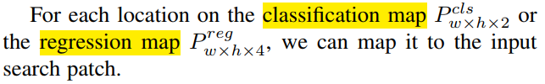
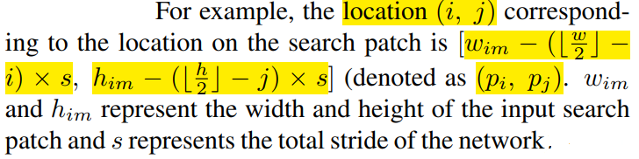
Tracker Framework [continue]
In order to take full advantage of multi-level features, they fused the classification and regression heads as,

Slide 5

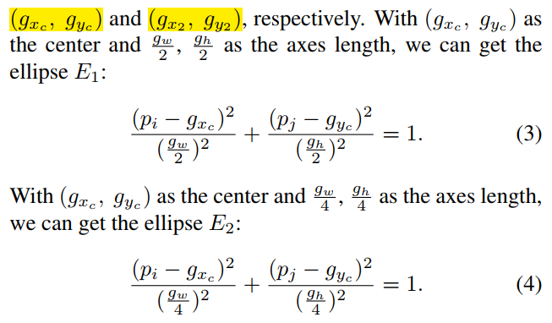
Positive and negative label assignment

Slide 6
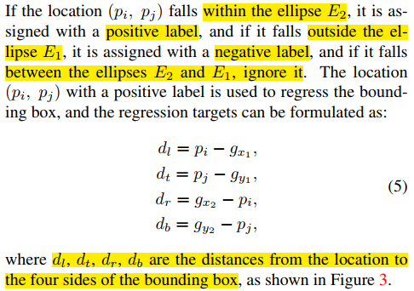
Bounding box regression

Slide 7
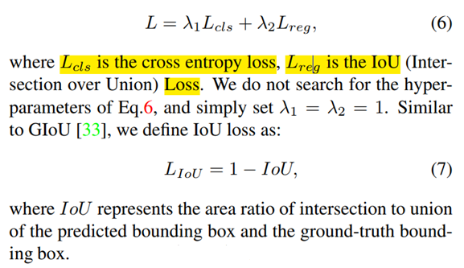
Loss calculation
The overall loss function is calculated as

Slide 8
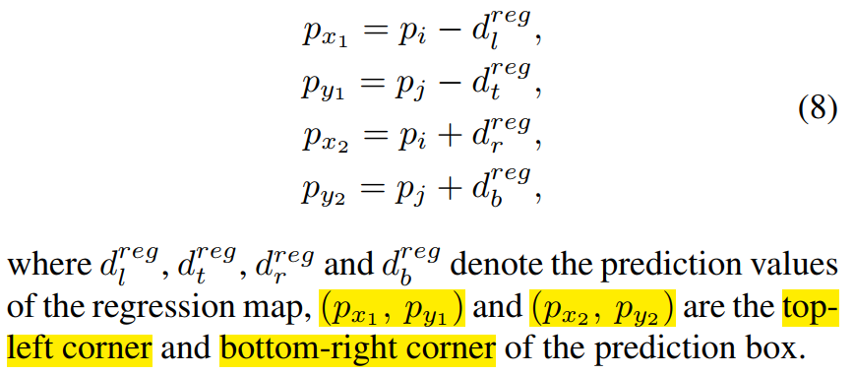
Bounding box predication
Therefore, they computed their predicted bounding box as

Slide 9
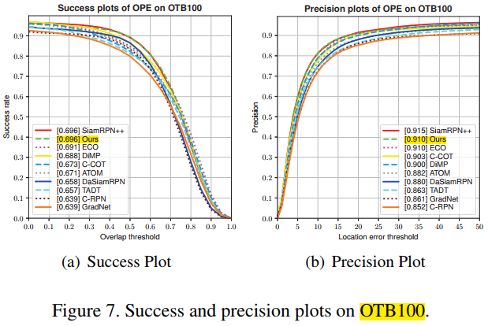
Experimental results on OTB100 benchmark

Slide 10
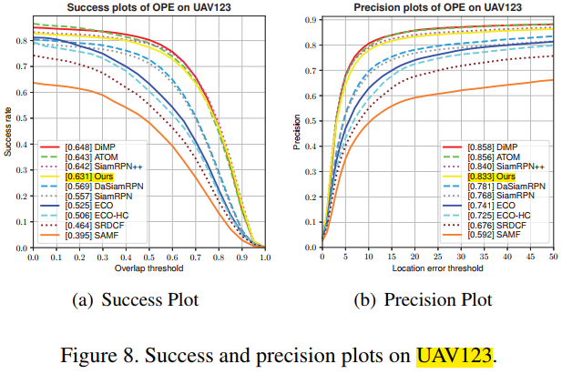
Experimental results on UAV123 benchmark

Slide 11
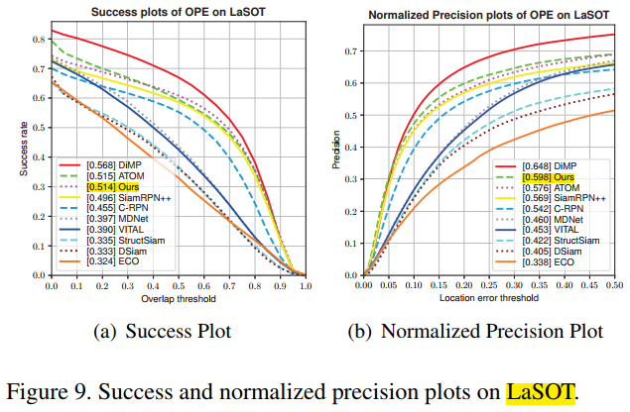
Experimental results on LaSOT benchmark

Slide 12
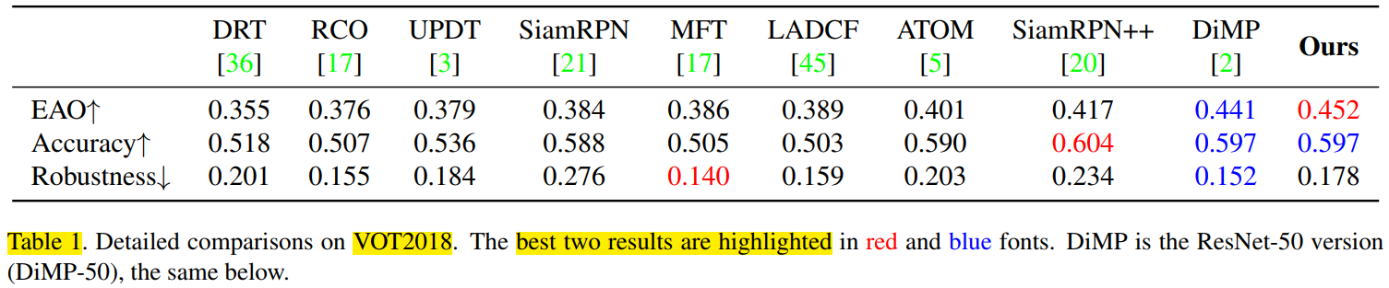
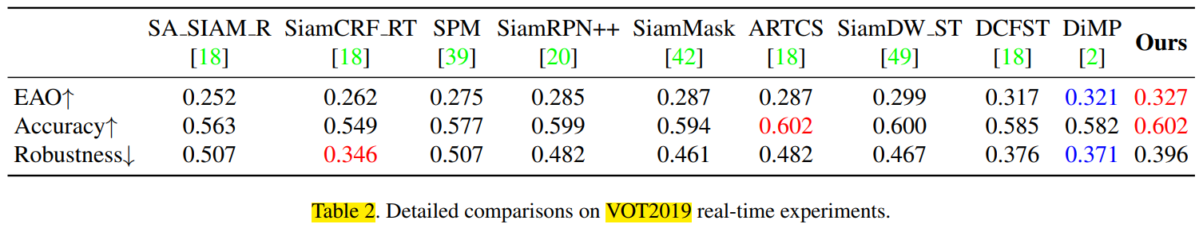
Experimental results on VOT benchmarks

Slide 13
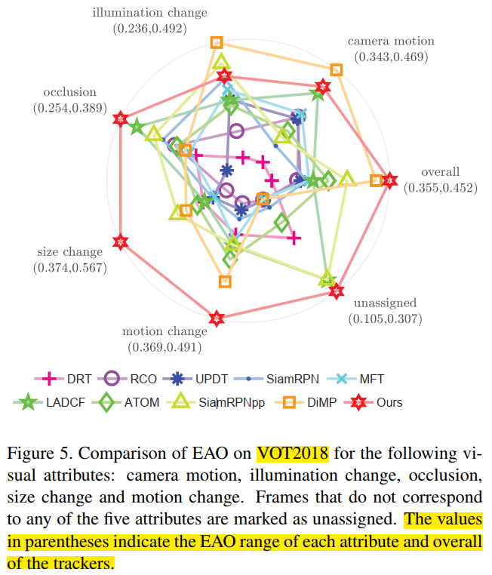
Challenges on VOT2018 benchmark

Slide 14
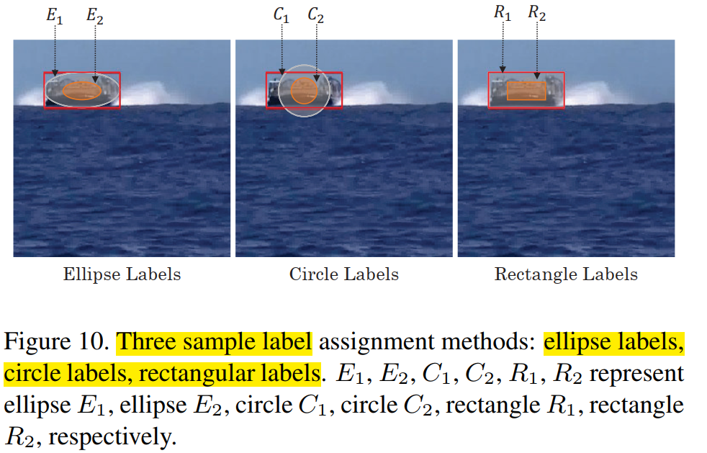
Ablation study on sample label assignment

Slide 15
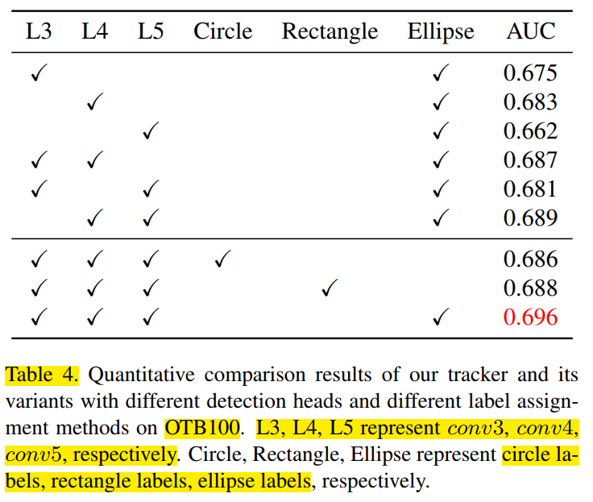
Ablation study on OTB100 benchmark

Slide 16
Conclusion
SiamBAN directly classifies objects and regresses bounding boxes in a unified network.
Extensive experiments on several tracking benchmarks demonstrate that SiamBAN achieves state-of-the-art performance.
SiamBAN runs at 40 FPS that confirms its effectiveness and efficiency.

Slide 17
감사합니다 (Thank you) Q&A

